Slide 1
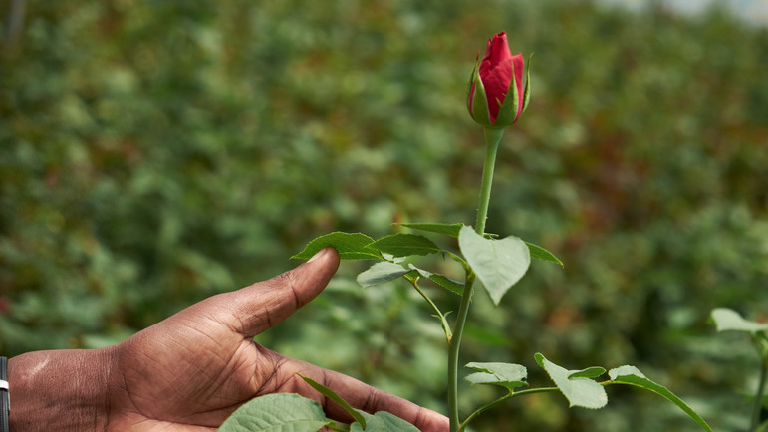


€3 million Fairtrade Premium generated for Flower workers in 2022

